Slide 1


HCP Journey Workshop 1
Tuesday 23rd March
Core project team

Slide 2
HCP Journey Workshop 1
Tuesday 23rd March
Core project team

Slide 3
Workshop Context
Workshop Objectives
Before jumping into the creation of our HCP Journeys, we need to ensure we are working from the same principles, and the framework for how they should be created.
From the principles & framework, we can create a template that achieves these goals.
Define, agree and prioritise the Journey Principles - 30mins
Define, agree and prioritise the Journey framework – 90mins

Slide 4
Let’s have an efficient session!
Time Keeper
‘Rabbit hole’ Monitor
Keeps us on-time and reminds the group when we need to move forward
If we go ‘off-topic’ from the meeting objectives, the monitor will raise speak up, note the topic for a follow-up, and bring us back to topic.
Alex Richwood
Louisa

Slide 5
Journey Principles
Journey Framework
What should the journeys be?
How should the journeys be created?
Guiding statements to ensure the journeys are fit for purpose:
For example:
Simple
Local
Using existing (and planned) content/assets
Linked to key events
Detailing the different factors that make up the journey
For example:
The journeys won’t be segmented
The journeys steps will link directly to content in SharePoint
The journeys will be linked to an adoption ladder
Differentiate between message/content/asset
Introduce a dictionary for what these are

Slide 6


Customer Journey Principles
List out your core principles for building Customer Journeys
10 mins

Slide 7

Journey Principles Exercise
20mins
Journey Principles
Journey Principles
What should the journeys be? – Simple | Local | etc
What is the priority?
Practical / Pragmatic
Reflect brand plan and prioritization of activation
Simple
Addressing customer needs and preferences – leveraging market research (content, channel, style, time)
Local
Actionable today = channel maturity, content is there, (relevant consent exists- add an icon where the consent is actually needed)
Practical, Usable, end-to-end UJ (that even shows potential connections between journey to journey), continuous communication
Powered by Insight & data (try to combine where possible to see 360 view)
‘Aligned to CRM/CDP’
Cross- functional (input. Output is moreso FF + Marketeer initially)
Various access points (into journey)
Linked to key events
Journeys are connected and not in isolation
…
Leverages digital and physical touchpoints
Don’t reinvent material that has already been validated (standardise the templates, use existing materials to help build it)
Based on fact, not feeling (where possible)

Slide 8
Journey Principles Exercise
20mins
Journey Principles
Journey Principles
What should the journeys be? – Simple | Local | etc
What is the priority?
Simple (not overcomplicated)
Based on real events
Using existing content and channels – developed by international, and developed locally
Localised to the market
‘Aligned to CRM/CDP’
Leveraging existing data – Eg Navigator and Pulse
Executes the latest RA campaign
Leverages digital and physical touchpoints
Don’t reinvent material that has already been validated (standardise the templates, use existing materials to help build it)
…
…
…

Slide 9
Customer Journey Framework
What are the framework elements that we should include in the journeys?

Slide 10


Proposal
Aligned to Adoption Ladder (with specific alignment to events)
1-3/4 steps
Secil: ‘cycle' is belongs to GLPG way of working in sales teams – easier to execute in rep cycle plans
UK have an OC plan, with monthly check-ins (calendar-focus?)
(use local cycle plan to help define the number of touchpoints for a journey in a timeframe)
International aligned to Adoption – and then offer calendar alignment at the local level for pragmatic execution (being careful not to duplicate brand and sales management/execution)
Including all 5 stages, ensuring focus on converting mavericks to advocates
5 mins

Slide 11



CURRENT
DESIRED
Behaviour Change
Uses a very broad spectrum of products including JAKs
Uses very recently launched products
Able to talk extensively about new and pipeline treatments
Willing to act ahead of guidelines
Tries JYSELECA with some patients
(After they have gained experience) Expand JYSELECA use in a wider range of patients in preference to other JAKs
Unmet Need
Research
1st Rx
Prescribes
Advocates
Adoption Stage
Uses a wide variety of treatments 1st line, including JAKs
Reflects on early JYSELECA experience & positive efficacy outcomes compared with other JAKs
Prescribes JYSELECA as their ‘go to’ JAK
Shares positive experiences with colleagues
Advocates JYSELECA as JAK of choice
To demonstrate that the burden of the disease including side effects is more significant that currently thought.
Galapagos Goal
Highly competitive environment with comparisons between treatments hard to make.
Treatment inertia and need to overcome mindset shift
Barriers
<Insert Message related to existing treatment data>
<Branded messaging introduced>
Messages
Message Source
KOL Video
Study x
Guidelines
Be clear to markets that this is the starting point –with local segmentation preference applied, show why we’re focusing one segment, show research

Slide 12
Proposal
How will time-specific events be incorporated, if not aligned to calendar? (Pre-during-post event?)
Have to link to adoption because it’s important
Pre-during-post EULAR.
1 big events for RA
2 events for IBD
Connected the normal journeys with ’entry’ and ‘exit points’
Don’t rebuild the EULAR journeys, focus instead on connecting it to the core HCP journeys
Markets will have other related activities such as regular webinars
5 mins

Slide 13
Decision 2
Will there be multiple ‘scenarios’ for each adoption phase?
Notes
5 mins

Slide 14
Decision 2.1
Will these scenarios be split by function? (Rep/Digital/Event)?
Are the journeys going to be connected between physical and digital? Rep journeys and digital-only Journeys? (should be focused on continuing engagement in their preferred channel, as opposed to forcing a digital – physical direction)
Yes
A few scenarios per adoption stage, eg 1 digital only, 2 hybrid?
Hybrid versions are priority -
Or engaged vs unengaged entry points?
5 mins

Slide 15
Proposal
We will connect (hyperlink) the touchpoints to real content.
Decision: to Vault, or SharePoint, or agency repository?
Nice to have.
Try it – and see if it works/is valuable.
Decide later
At the very least, link to the materials repository/sharepoint/vault.
5 mins

Slide 16
Decision 6
Should we highlight what data we will be capturing at each stage?
What data shall we use for channel selection?
Navigator/Behavioural Affinities (segmentation) CRM/Pulse/Market Research/
Markets also have some third party data on channel preferences, eg from Medscape etc.
For the Journeys – proposed to add suggested KPIs for that touchpoint?
Partly tbd
5 mins

Slide 17
Decision 7
How granular? Are we listing ALL touchpoints, or higher level, executable examples of journeys?
Notes
5 mins

Slide 18
Decision 8
How do we incorporate future plans for dynamic journeys into the initial journeys?
Notes
5 mins

Slide 19
Decision 9
How visually shall we connect the touchpoints?
Notes
5 mins

Slide 20
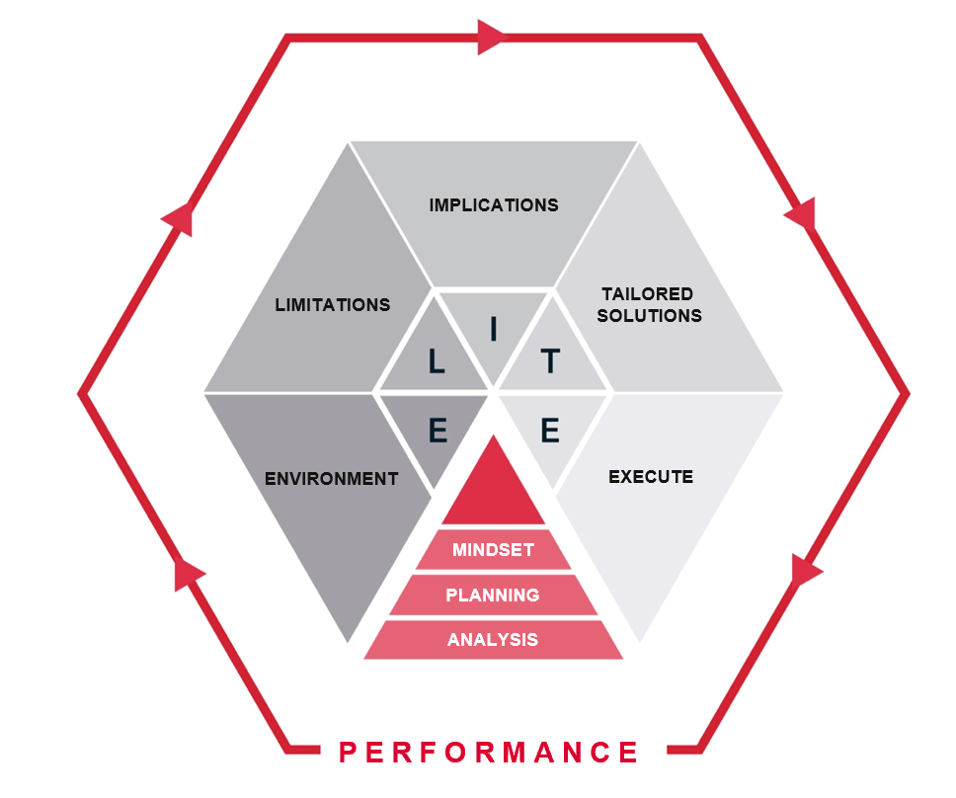
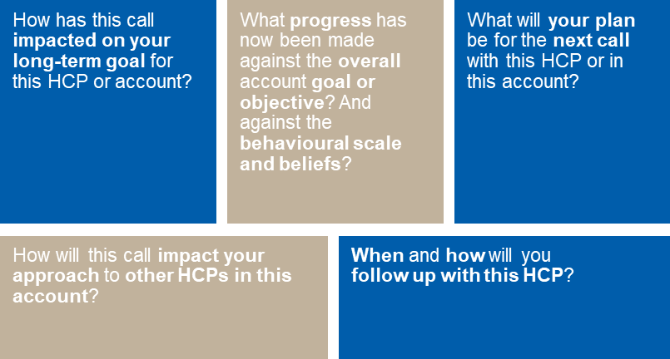
Decision 12
How we do we incorporate the 5 stage performance analysis / planning into the journeys?
Notes
5 mins

Slide 21
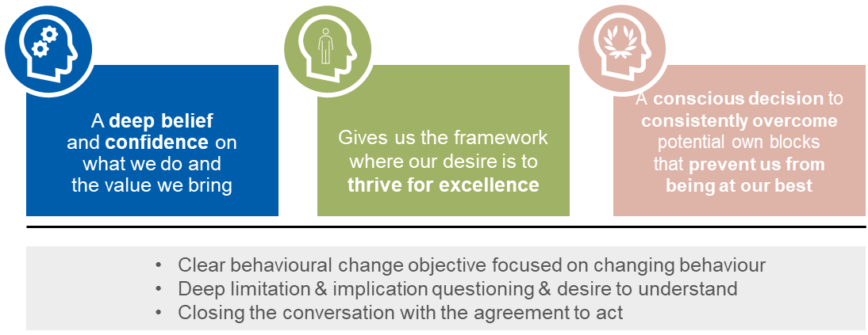
Decision 13
How we do we incorporate the ‘Winning Mindsets’narrative?
Notes
5 mins

Slide 22

Next Steps
Veeva will prepare some proposed template/tool options, based upon the principles and framework discussion, for review during the Friday workshop

